Slide 1
My Republic: Chuvashia
Houses, odd buildings, churches

Slide 2
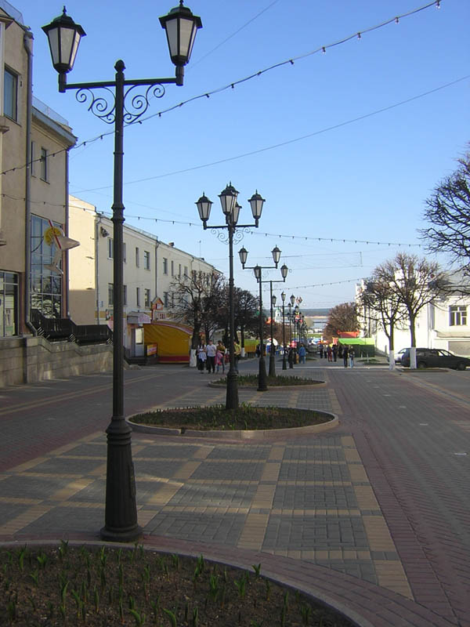
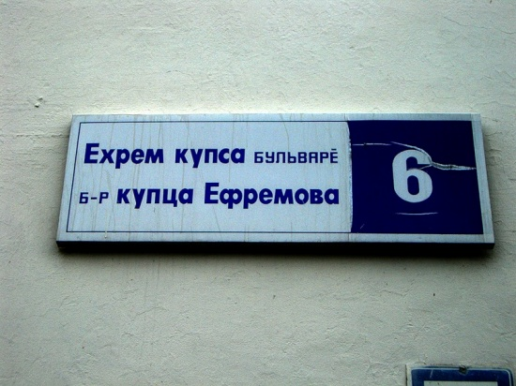
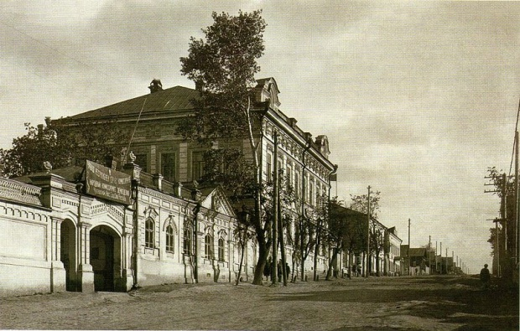
Boulevard of Ephraim merchant
Boulevard is named in honor of the merchant Procopius Efremovich Ephraim, Chuvash, philanthropist, founder of the dynasty of Ephraim, which has made a lot of improvement to the Cheboksary.
The Home of Procopius Ephraim was founded in 1884 year in Blagoveschenskaya street. Now this building is the Chuvash National museum in Cheboksary.

Slide 3
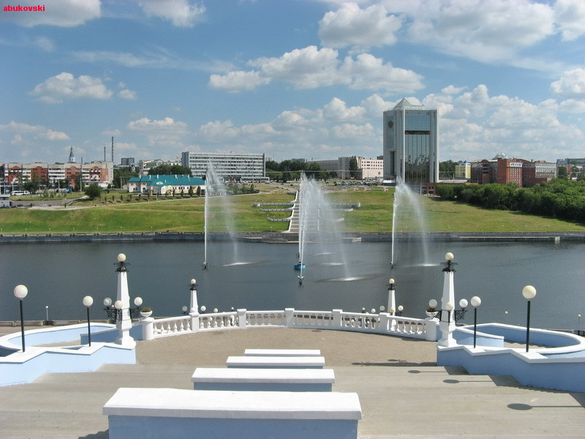
Zaliv
It is the most beautiful place in Cheboksary. Zaliv is the place where people of Cheboksary can relax, eat, swim in catamarans and boats.

Slide 4
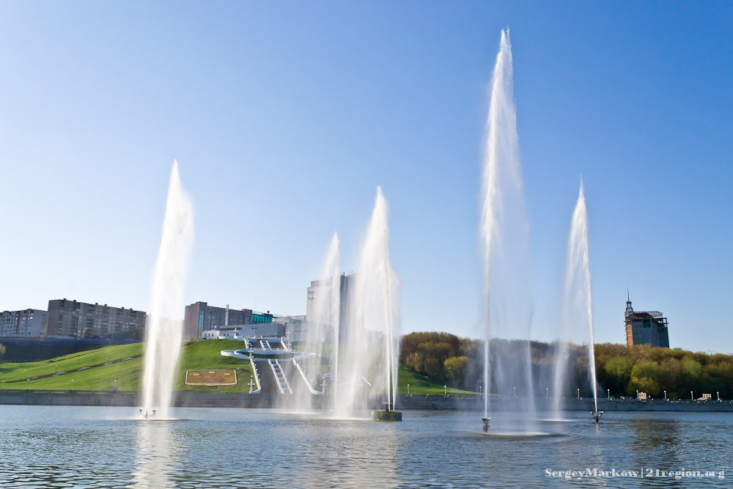
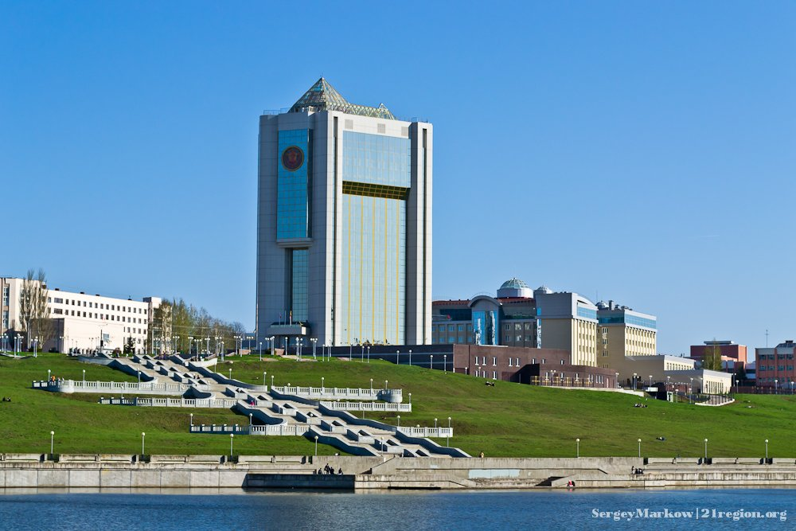
Fountains of the Zaliv
Palace of the President of Chuvashia

Slide 5
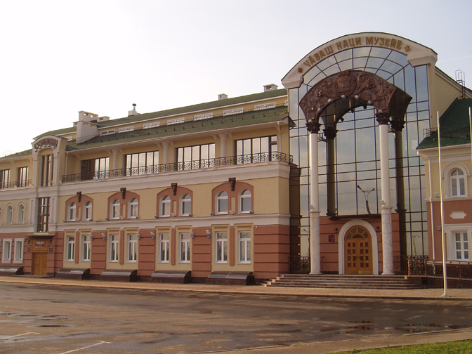
The Chuvash National museum
The largest repository of monuments of nature, history, material and spiritual culture of the Chuvash and other ethnic groups, the center of all the museum's work on the territory of the Chuvash Republic.
All major museums are affiliates of this museum.

Slide 6
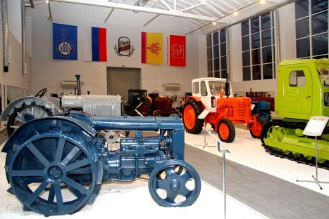
The Museum of the history of tractors
Recently (October 2011) in Cheboksary has been opened a unique museum of the history of tractors which is one in Russia. The opening was attended by President of Chuvashia M. Ignatiev. The initiator of the museum is the Concern Tractor Plant. The exhibits for the museum are collected from all over Russia.

Slide 7
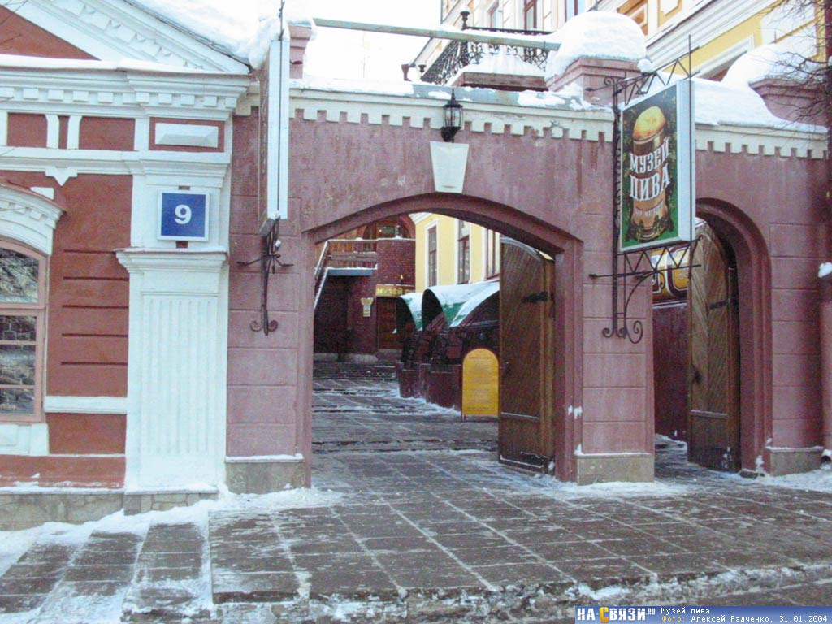
The Cheboksary Beer Museum
It was created in 1997 by the President of the Chuvash Republic N.V. Fyodorov.
Today, the exposition of the Museum of Beer acquaints visitors with the complete biography of beer, starting with the first mentions of this drink on the clay tablets of Ancient Sumeria and ending our days. During multi-millennial history of beer there were a lot of changes - in preparation technology and in its place in society.

Slide 8
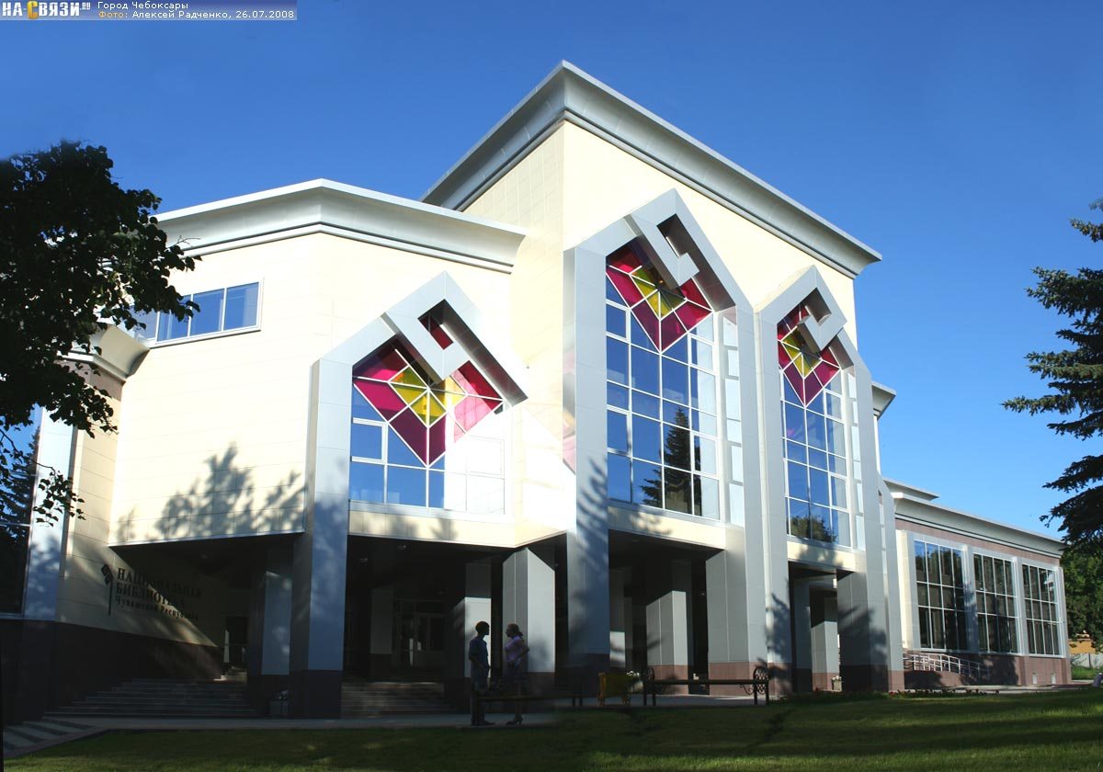
The National Library of the Chuvash Rebublic
This library is the newest publicly available information center which serves legislative and executive branches of the Chuvash Republic, and it`s regional methodical center.

Slide 9
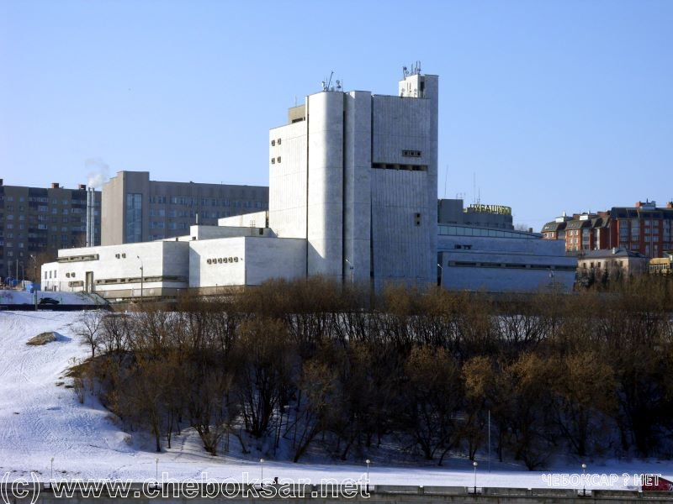
Theatres
The Chuvash State Opera and Ballet theatre
The most popular theatre in Chedoksary is the Chuvash State Opera and Ballet theatre. The theatre was founded as the Chuvash State Musical theatre. There are the best dancers, actors and designers; good speeches and ballets. Here there are always many people, who want to see theatre performances.
But there are two not less popular theatres: The Russian Drama theatre and the Chuvash Drama theatre.
theatre

Slide 10
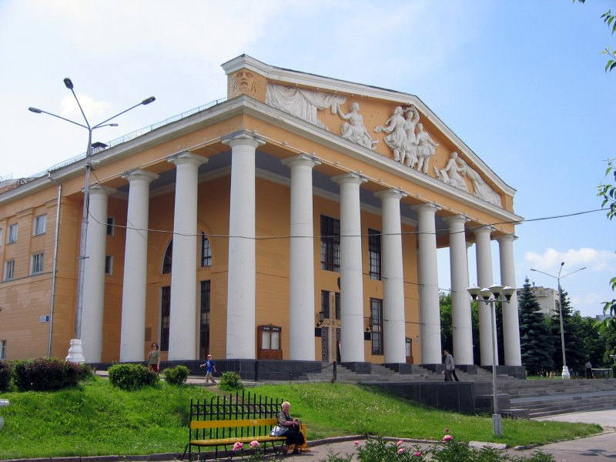
This is the Chuvash Drama Theatre. It`s called in honor of Konstantin Ivanov and founded on January 27, 1918 year.
This is the Russian Drama Theatre. It was founded in 1918 .

Slide 11
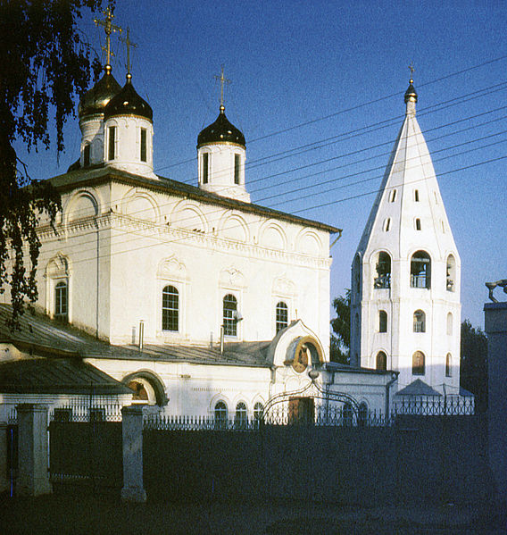
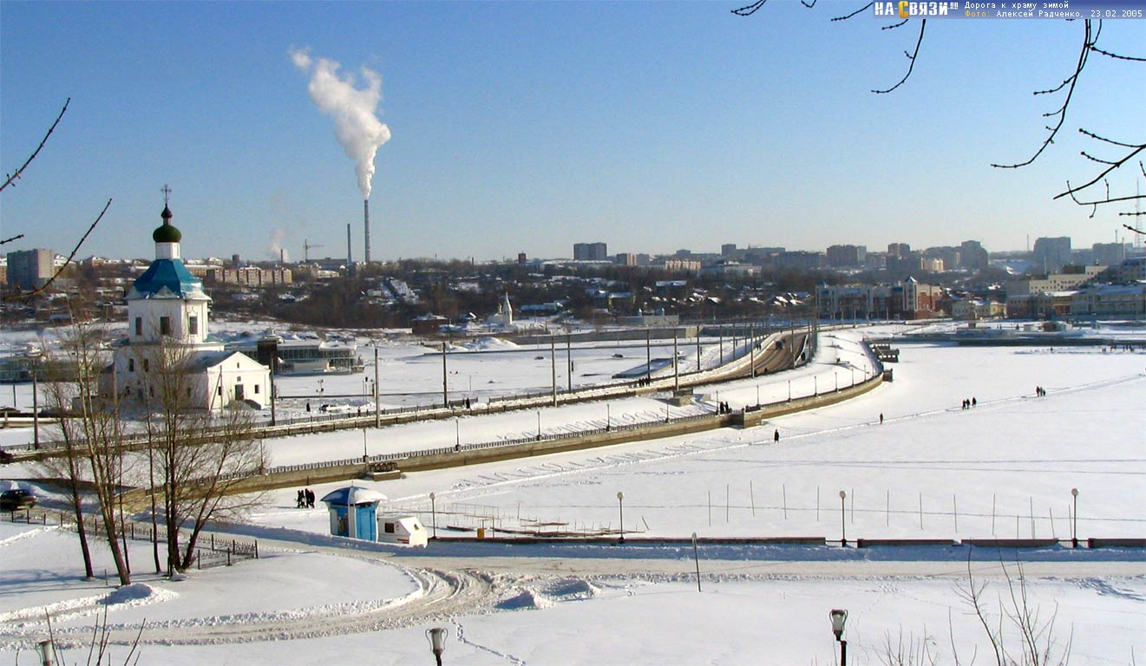
Churches
Cathedral of the Presentation of the Blessed Virgin
The cathedral is the oldest church in Chuvashia. This is the only surviving monument of the XVII century. The cathedral was founded by decree of Ivan the Terrible and blessed by Gurii Kazansky in 1555 year. Leads to the cathedral the famous road to the temple.

Slide 12
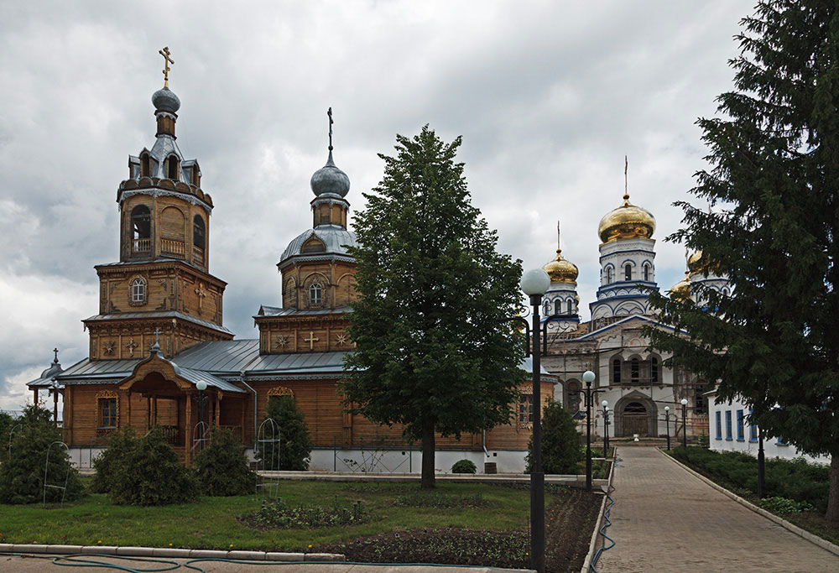
Tsivilsk Tikhvin Monastery
Founded in 1671 - 1675 years by Tsivilsk citizens in gratitude for the liberation of the city from the rebel Stenka-Razin. First, the monastery was a male, but in 1870 turned into a female. There is deeply revered icon of the Virgin of Tikhvin. The monastery school and orphanage.

Slide 13
Thank you for your attention!

